Slide 1

Theater Revenue Analysis Tool POC:
Presented by:
Keerthi B K
Durga
U Kavya
S M Subhashini

Slide 2
Problem statement:
Theater Revenue Analysis Tool POC:
• CRUD: Revenue data.
• analyze_theater_revenues(theater_id): Analyze revenue streams from ticket sales, concessions, and merchandise.
• suggest_revenue_enhancement_strategies(strategy_data): Suggest strategies to enhance revenue.

Slide 3
Introduction :
Theater revenue typically comes from ticket sales, concessions, sponsorships, and sometimes merchandise sales. It's crucial for theaters to balance revenue streams to ensure financial sustainability.
These avenues include ticket sales, which represent the primary source of income, as well as concessions, where snacks and beverages are sold to enhance the audience's experience.
Some theaters also generate revenue through merchandise sales, such as T-shirts, posters, and other memorabilia related to their productions.

Slide 4
Requirement Analysis :
Programming and contents
Revenue tracking
Ticket sales and pricing strategy
Concessions and merchandise
Discounts and combo offers

Slide 5
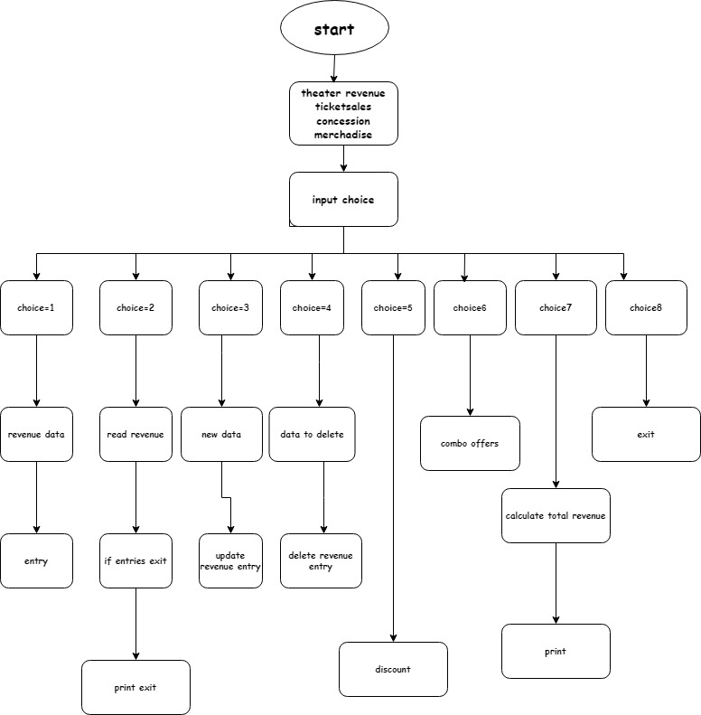
Flow Chart:

Slide 6
Funtions:
from abc import ABC, abstractmethod
class TheaterRevenue(ABC):
def __init__(self, theater_id, ticket_sales, concessions, merchandise):
self.theater_id = theater_id
self.ticket_sales = ticket_sales
self.concessions = concessions
self.merchandise = merchandise
self.revenues = []
self.default_discount = 10 # Default discount percentage
@abstractmethod
def create_revenue_entry(self, revenue_data):
pass
@abstractmethod
def read_revenue_entry(self):
pass
@abstractmethod
def update_revenue_entry(self, new_data):
pass

Slide 7
def read_revenue_entry(self):
pass
def update_revenue_entry(self, new_data):
pass
def delete_revenue_entry(self, data):
pass
def revenue_strategy(self):
pass
def apply_discount(self, discount_percentage=None):
pass
def add_combo_offer(self, combo_offer):
pass

Slide 8
from theater_revenue import TheaterRevenue
class ConcreteTheaterRevenue(TheaterRevenue):
def create_revenue_entry(self, revenue_data):
self.revenues.append(revenue_data)
print("Revenue entry created successfully.")
def read_revenue_entry(self):
if self.revenues:
return self.revenues
else:
print("No revenue entries available.")
return None
def update_revenue_entry(self, new_data):
if self.revenues:
self.revenues[-1] = new_data # Update the last entry
print("Entry updated successfully.")
else:
print("No entries available. Entry not updated.")

Slide 9
def delete_revenue_entry(self, data):
if data in self.revenues:
self.revenues.remove(data)
print("Entry deleted successfully.")
else:
print("Entry not found. No entry deleted.")
def revenue_strategy(self):
total_revenue = 0
for entry in self.revenues:
total_revenue += entry[1] * self.ticket_sales
total_revenue += entry[2] * self.concessions
total_revenue += entry[3] * self.merchandise
return total_revenue
def apply_discount(self, discount_percentage=None):
if discount_percentage is None:
discount_percentage = self.default_discount

Slide 10
if self.revenues:
for entry in self.revenues:
entry[1] -= entry[1] * (discount_percentage / 100)
entry[2] -= entry[2] * (discount_percentage / 100)
entry[3] -= entry[3] * (discount_percentage / 100)
print(f"Discount of {discount_percentage}% applied successfully.")
else:
print("No entries available to apply discount.")
def add_combo_offer(self, combo_offer):
if self.revenues:
for entry in self.revenues:
if combo_offer["item_type"] == "ticket_sales":
entry[1] += combo_offer["discount_amount"]
elif combo_offer["item_type"] == "concessions":
entry[2] += combo_offer["discount_amount"]
elif combo_offer["item_type"] == "merchandise":
entry[3] += combo_offer["discount_amount"]
print("Combo offer applied successfully.")
else:
print("No entries available to apply combo offer.")

Slide 11
from concrete_theater_revenue import ConcreteTheaterRevenue
theater_rev = ConcreteTheaterRevenue(theater_id="ABC123", ticket_sales=10, concessions=5, merchandise=3)
while True:
print("\n===== Theater Revenue Management =====")
print("1. Create Revenue Entry")
print("2. Read Revenue Entries")
print("3. Update Revenue Entry")
print("4. Delete Revenue Entry")
print("5. Apply Discount")
print("6. Apply Combo Offer")
print("7. Calculate Total Revenue")
print("8. Exit")
choice = input("Enter your choice (1-8): ")

Slide 12
if choice == "1":
revenue_data = input(
"Enter revenue data (comma-separated - theater_id, ticket_sales, concessions, merchandise): ")
revenue_data = revenue_data.split(",")
revenue_data = [float(x) for x in revenue_data]
theater_rev.create_revenue_entry(revenue_data)
elif choice == "2":
entries = theater_rev.read_revenue_entry()
if entries:
print("\nRevenue Entries:")
for i, entry in enumerate(entries, 1):
print(f"{i}. {entry}")
elif choice == "3":
new_data = input("Enter new revenue data to update (comma-separated): ")
new_data = new_data.split(",")
new_data = [float(x) for x in new_data] # Convert numerical data to float
theater_rev.update_revenue_entry(new_data)

Slide 13
elif choice == "4":
data_to_delete = input("Enter revenue data to delete (comma-separated): ")
data_to_delete = data_to_delete.split(",")
data_to_delete = [float(x) for x in data_to_delete] # Convert numerical data to float
theater_rev.delete_revenue_entry(data_to_delete)
elif choice == "5":
theater_rev.apply_discount()
elif choice == "6":
item_type = input("Enter item type for combo offer (ticket_sales, concessions, merchandise): ")
discount_amount = float(input("Enter discount amount for the combo offer: "))
combo_offer = {"item_type": item_type, "discount_amount": discount_amount}
theater_rev.add_combo_offer(combo_offer)

Slide 14
elif choice == "7":
total_revenue = theater_rev.revenue_strategy()
print(f"Total revenue: ${total_revenue}")
elif choice == "8":
print("Exiting program.")
break
else:
print("Invalid choice. Please enter a number from 1 to 8.")

Slide 15
Outputs:
===== Theater Revenue Management =====
1. Create Revenue Entry
2. Read Revenue Entries
3. Update Revenue Entry
4. Delete Revenue Entry
5. Apply Discount
6. Apply Combo Offer
7. Calculate Total Revenue
8. Exit
Enter your choice (1-8): 1
Enter revenue data (comma-separated - theater_id, ticket_sales, concessions, merchandise): 125,20,30,50
Revenue entry created successfully.

Slide 16
===== Theater Revenue Management =====
1. Create Revenue Entry
2. Read Revenue Entries
3. Update Revenue Entry
4. Delete Revenue Entry
5. Apply Discount
6. Apply Combo Offer
7. Calculate Total Revenue
8. Exit
Enter your choice (1-8): 2
Revenue Entries:
1. [125.0, 20.0, 30.0, 50.0]

Slide 17
===== Theater Revenue Management =====
1. Create Revenue Entry
2. Read Revenue Entries
3. Update Revenue Entry
4. Delete Revenue Entry
5. Apply Discount
6. Apply Combo Offer
7. Calculate Total Revenue
8. Exit
Enter your choice (1-8): 3
Enter new revenue data to update (comma-separated): 125,82,60,20
Entry updated successfully.

Slide 18
===== Theater Revenue Management =====
1. Create Revenue Entry
2. Read Revenue Entries
3. Update Revenue Entry
4. Delete Revenue Entry
5. Apply Discount
6. Apply Combo Offer
7. Calculate Total Revenue
8. Exit
Enter your choice (1-8): 4
Enter revenue data to delete (comma-separated): 125,20,30,40
Entry not found. No entry deleted.

Slide 19
===== Theater Revenue Management =====
1. Create Revenue Entry
2. Read Revenue Entries
3. Update Revenue Entry
4. Delete Revenue Entry
5. Apply Discount
6. Apply Combo Offer
7. Calculate Total Revenue
8. Exit
Enter your choice (1-8): 5
Discount of 10% applied successfully.

Slide 20
===== Theater Revenue Management =====
1. Create Revenue Entry
2. Read Revenue Entries
3. Update Revenue Entry
4. Delete Revenue Entry
5. Apply Discount
6. Apply Combo Offer
7. Calculate Total Revenue
8. Exit
Enter your choice (1-8): 6
Enter item type for combo offer (ticket_sales, concessions, merchandise): 10,10,10
Enter discount amount for the combo offer: 10
Combo offer applied successfully.

Slide 21
===== Theater Revenue Management =====
1. Create Revenue Entry
2. Read Revenue Entries
3. Update Revenue Entry
4. Delete Revenue Entry
5. Apply Discount
6. Apply Combo Offer
7. Calculate Total Revenue
8. Exit
Enter your choice (1-8): 7
Total revenue: $1062.0

Slide 22
===== Theater Revenue Management =====
1. Create Revenue Entry
2. Read Revenue Entries
3. Update Revenue Entry
4. Delete Revenue Entry
5. Apply Discount
6. Apply Combo Offer
7. Calculate Total Revenue
8. Exit
Enter your choice (1-8): 8
Exiting program.

Slide 23
Challenges:
Rising Costs: Running a theater involves significant expenses, including production costs, rent, utilities, salaries, and more. Balancing these costs with revenue can be a constant challenge.
Pricing Strategy: Determining ticket prices that are both attractive to audiences and generate sufficient revenue can be tricky. Setting prices too high may deter potential attendees, while setting them too low may not cover costs.
Revenue Split: In cases where theaters host productions from different companies or artists, negotiating revenue splits can be complex. Ensuring fair agreements that benefit all parties involved can be a challenge.
Seasonal Demand: The demand for theater shows can vary throughout the year, with certain seasons being busier than others. Managing the ebb and flow of demand while maintaining consistent revenue can be a challenge.

Slide 24
Conclusion:
managing theater revenue involves various aspects such as accurate tracking, reporting, integration with ticketing systems, handling discounts and promotions, ensuring security and compliance, and scalability for future growth. By meeting these requirements, you can effectively manage and optimize the revenue generated by your theater.

Slide 25

Future Scope:
Merchandise Sales: Theaters can capitalize on the popularity of their productions by selling merchandise like t-shirts, posters, and collectibles. Fans love to show their support and having branded merchandise can be a great way to generate additional income.
Partnerships with Local Businesses: Theaters can collaborate with local businesses, such as restaurants, hotels, or tourism agencies, to offer package deals that include theater tickets along with dining or accommodation options. This can attract tourists and boost revenue for both the theater and the partnering businesses.

